Slide 1

CSE 470/598 Final Review
Ross Maciejewski
rmacieje@asu.edu

Slide 2
Disclaimer
These slides can only be used as study material for the class 470 at ASU
The slides cannot be distributed or used for another purpose

Slide 3
Final Exam
12/11/2014
7:30AM – 9:20 AM
BYAC 120
25% of final grade

Slide 4
Materials Covered
Refer to the textbook!
Lecture slides give an indication
All available from Blackboard Vista site
Not all material covered during lectures!
Will review some here
Good idea to
Review textbook
Review linear algebra

Slide 5
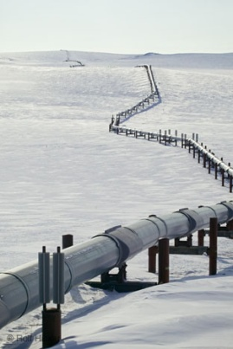
The Graphics Pipeline
Process objects one at a time in the order they are generated
Can consider only local lighting
Pipeline architecture
All steps can be implemented in hardware on the graphics card
application
program
display

Slide 6
OpenGL is a State Machine!
Stores internal state
Color, transformation, line width, point size…
Two types of operations
Change state
Draw primitives
Metaphor: artist’s kit (palette, canvas, paintbrushes)
Color
Brush size
Position on canvas

Slide 7
Geometry
Need three basic elements in geometry
Scalars, Vectors, Points
Scalars can be defined as members of sets which can be combined by two operations (addition and multiplication) obeying some fundamental axioms (associativity, commutivity, inverses)
Examples: the real and complex number systems under ordinary rules
Scalars alone have no geometric properties

Slide 8
Homogeneous Coordinates
The homogeneous coordinates form for a three-dimensional point [x y z] is given as
p =[x’ y’ z’ w] ^{T} =[wx wy wz w] ^{T}
We return to a three dimensional point (for w ≠ 0) by
x ← x’/ w
y ← y’/ w
z ← z’/ w
If w = 0, the representation is that of a vector
Note that homogeneous coordinates replaces points in three dimensions by lines through the origin in four dimensions
For w = 1, the representation of a point is [x y z 1]

Slide 9
Translations
Can be used to express a translation using a 4 x 4 matrix T in homogeneous coordinates
p’=Tp where
T = T(d_{x}, d_{y}, d_{z}) =
This form is better for implementation because all affine transformations can be expressed this way and multiple transformations can be concatenated together

Slide 10
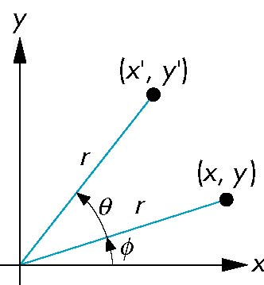
Rotations
Consider rotation about the origin by θ degrees
radius stays the same, angle increases by θ
x’ = r cos (φ + θ)
y’ = r sin (φ + θ)
x’ = x cos θ –y sin θ
y’ = x sin θ + y cos θ
x = r cos φ
y = r sin φ
Notes:
Cos(x + y) = cos x cos y – sin x sin y
Sin(x + y) = sin x cos y + cos x sin y

Slide 11
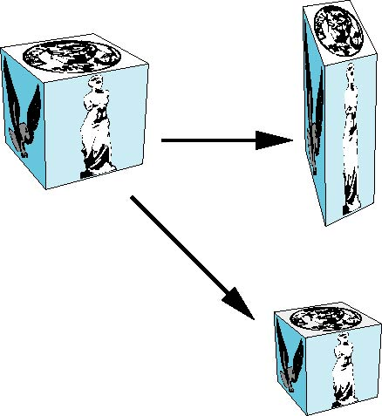
Scalings
Expand or contract along each axis (fixed point of origin)
x’ = s_{x} x
y’ = s_{y} y
z’ = s_{z} z
p’=Sp
S = S(s_{x}, s_{y}, s_{z}) =

Slide 12
Light Equation
OpenGL light computation
Light intensity I computed for each color component (R, G, B)
3D-vector (but not for x, y, z)
I = I_{D} + I_{S} + I_{A}

Slide 13
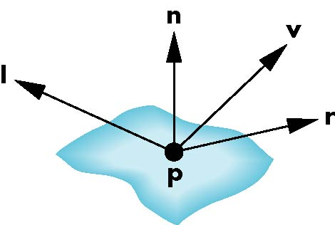
Phong Model
A simple model that can be computed rapidly
Has three components
Diffuse
Specular
Ambient
Uses four vectors
To source
To viewer
Normal
Perfect reflector

Slide 14
Lambertian Surface
Perfectly diffuse reflector
Light scattered equally in all directions
Amount of light reflected is proportional to the vertical component of incoming light
reflected light ~cos θ_{i}
cos θ_{i} = l · n if vectors normalized
There are also three coefficients, k_{r}, k_{b}, k_{g} that show how much of each color component is reflected

Slide 15
Modeling Specular Relections
Phong proposed using a term that dropped off as the angle between the viewer and the ideal reflection increased
I_{r} ~ k_{s} I cos^{α}φ
φ
reflected
intensity
shininess coef
incoming intensity
absorption coef

Slide 16
Defining a Point Light Source
For each light source, we can set an RGBA for the diffuse, specular, and ambient components, and for the position
GL float diffuse0[]={1.0, 0.0, 0.0, 1.0};
GL float ambient0[]={1.0, 0.0, 0.0, 1.0};
GL float specular0[]={1.0, 0.0, 0.0, 1.0};
Glfloat light0_pos[]={1.0, 2.0, 3,0, 1.0};
glEnable(GL_LIGHTING);
glEnable(GL_LIGHT0);
glLightv(GL_LIGHT0, GL_POSITION, light0_pos);
glLightv(GL_LIGHT0, GL_AMBIENT, ambient0);
glLightv(GL_LIGHT0, GL_DIFFUSE, diffuse0);
glLightv(GL_LIGHT0, GL_SPECULAR, specular0);

Slide 17
Material Properties
Material properties are also part of the OpenGL state and match the terms in the modified Phong model
Set by glMaterialv()
GLfloat ambient[] = {0.2, 0.2, 0.2, 1.0};
GLfloat diffuse[] = {1.0, 0.8, 0.0, 1.0};
GLfloat specular[] = {1.0, 1.0, 1.0, 1.0};
GLfloat shine = 100.0
glMaterialf(GL_FRONT, GL_AMBIENT, ambient);
glMaterialf(GL_FRONT, GL_DIFFUSE, diffuse);
glMaterialf(GL_FRONT, GL_SPECULAR, specular);
glMaterialf(GL_FRONT, GL_SHININESS, shine);

Slide 18
Gouraud and Phong Shading
Gouraud Shading
Find average normal at each vertex (vertex normals)
Apply modified Phong model at each vertex
Interpolate vertex shades across each polygon
Phong shading
Find vertex normals
Interpolate vertex normals across edges
Interpolate edge normals across polygon
Apply modified Phong model at each fragment

Slide 19
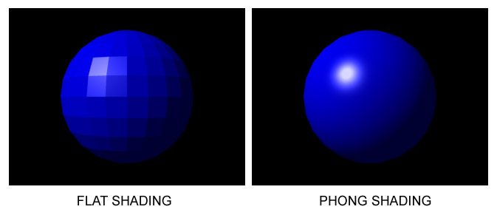
Fragment Colors
GOURAUD SHADING
LAMBERT SHADING

Slide 20
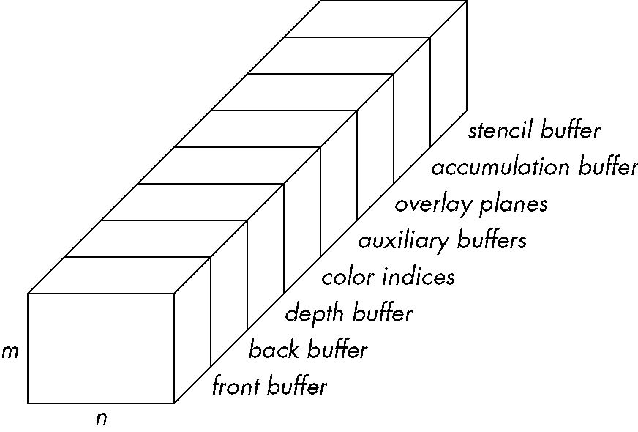
OpenGL Frame Buffer

Slide 21
Three Types of Mapping
Texture Mapping
Uses images to fill inside of polygons
Environment (reflection mapping)
Uses a picture of the environment for texture maps
Allows simulation of highly specular surfaces
Bump mapping
Emulates altering normal vectors during the rendering process

Slide 22
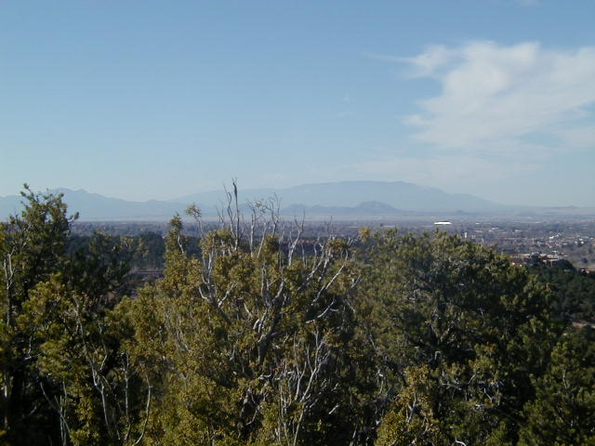
Texture Mapping
y
z
x
geometry
display
t
image
s

Slide 23
Coming Up…
Blending and compositing
Scene graphs
Interaction
Raytracing
Particle systems
Programmable pipelines
Curves and surfaces

Slide 24
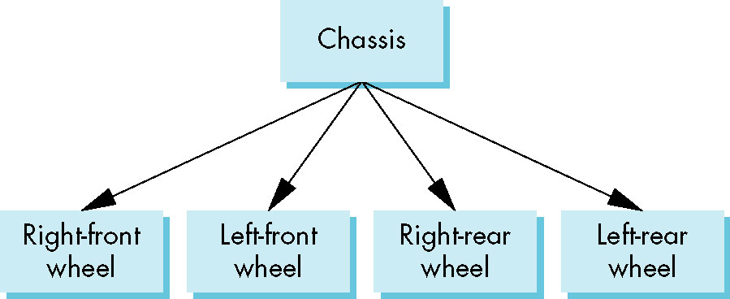
Tree Model of Car

Slide 25
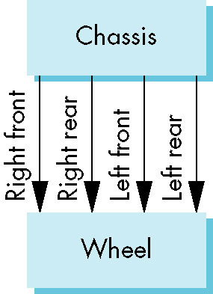
DAG Model
If we use the fact that all the wheels are identical, we get a directed acyclic graph
Not much different than dealing with a tree

Slide 26
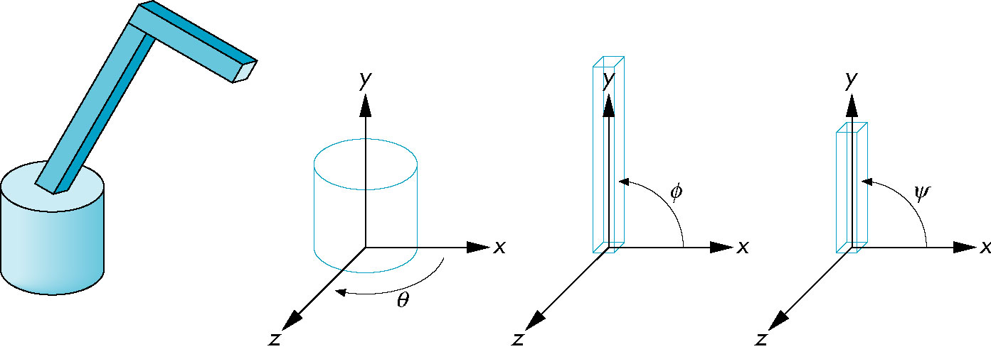
Robot Arm
parts in their own
coodinate systems
robot arm

Slide 27
Relationships in Robot Arm
Base rotates independently
Single angle determines position
Lower arm attached to base
Its position depends on rotation of base
Must also translate relative to base and rotate about connecting joint
Upper arm attached to lower arm
Its position depends on both base and lower arm
Must translate relative to lower arm and rotate about joint connecting to lower arm

Slide 28
Required Matrices
Rotation of base: R_{b}
Apply M = R_{b} to base
Translate lower arm relative to base: T_{lu}
Rotate lower arm around joint: R_{lu}
Apply M = R_{b} T_{lu} R_{lu} to lower arm
Translate upper arm relative to upper arm: T_{uu}
Rotate upper arm around joint: R_{uu}
Apply M = R_{b} T_{lu} R_{lu} T_{uu} R_{uu} to upper arm

Slide 29
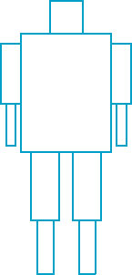
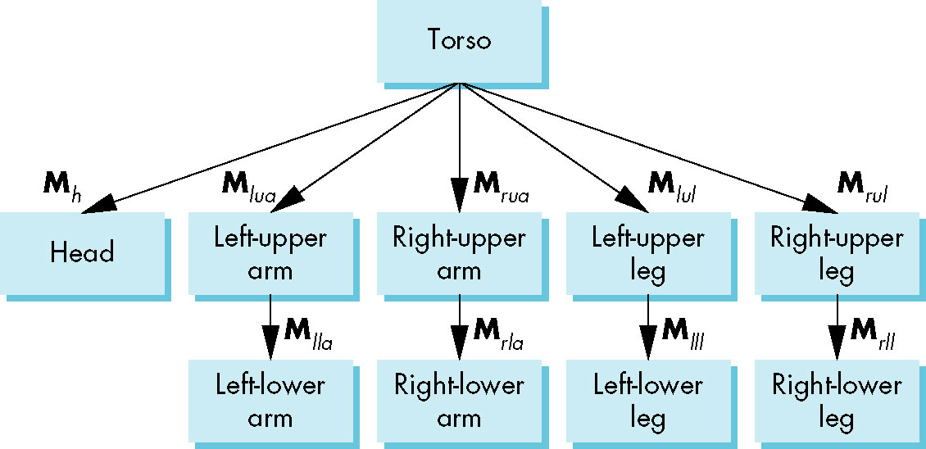
Humanoid (with Matrices)

Slide 30
Display and Traversal
The position of the figure is determined by 11 joint angles (two for the head and one for each other part)
Display of the tree requires a graph traversal
Visit each node once
Display function at each node that describes the part associated with the node, applying the correct transformation matrix for position and orientation

Slide 31

Opacity and Transparency
Opaque surfaces permit no light to pass through
Transparent surfaces permit all light to pass
Translucent surfaces pass some light
translucency = 1 – opacity (α)
opaque surface α =1

Slide 32
Writing Model
Use A component of RGBA (or RGBα) color to store opacity
During rendering we can expand our writing model to use RGBA values
blend
source blending factor
source
component
destination
component
destination blending
factor
Color Buffer

Slide 33
Fog
We can composite with a fixed color and have the blending factors depend on depth
Simulates a fog effect
Blend source color C_{s} and fog color C_{f} by
C_{s}’=f C_{s} + (1-f) C_{f}
f is the fog factor
Exponential
Gaussian
Linear (depth cueing)

Slide 34
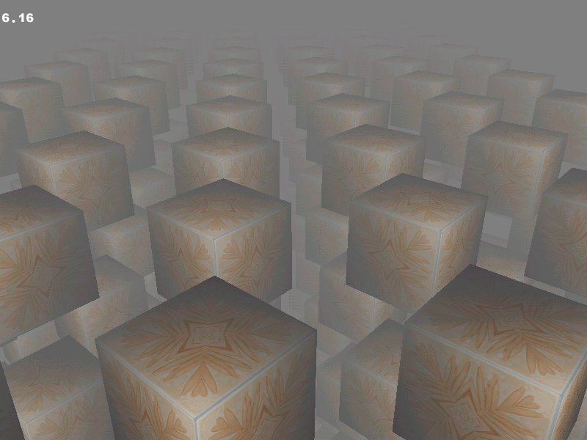
Fog Example

Slide 35
Introduction
OpenGL is based on a pipeline model in which primitives are rendered one at time
No shadows (except by tricks or multiple renderings)
No multiple reflections
Global approaches
Rendering equation
Ray tracing
Radiosity

Slide 36
Ray Casting
Only rays that reach the eye matter
Reverse direction and cast rays
Need at least one ray per pixel

Slide 37
Shadow Rays
Even if a point is visible, it will not be lit unless we can see a light source from that point
Cast shadow or feeler rays

Slide 38
Reflection
Must follow shadow rays off reflecting or transmitting surfaces
Process is recursive

Slide 39
Reflection and Transmission

Slide 40
Introduction
Fixed vs. programmable pipelines
Vertex shaders
Accepts 3D vertices in world space
Produces 3D vertices in clip space
Can modify position…
Fragment shaders
Accepts 2D position for new fragment
Produces color of fragment
Can implement procedural materials…

Slide 41
Vertex Shader Applications
Moving vertices
Morphing
Wave motion
Fractals
Lighting
More realistic models
Cartoon shaders

Slide 42
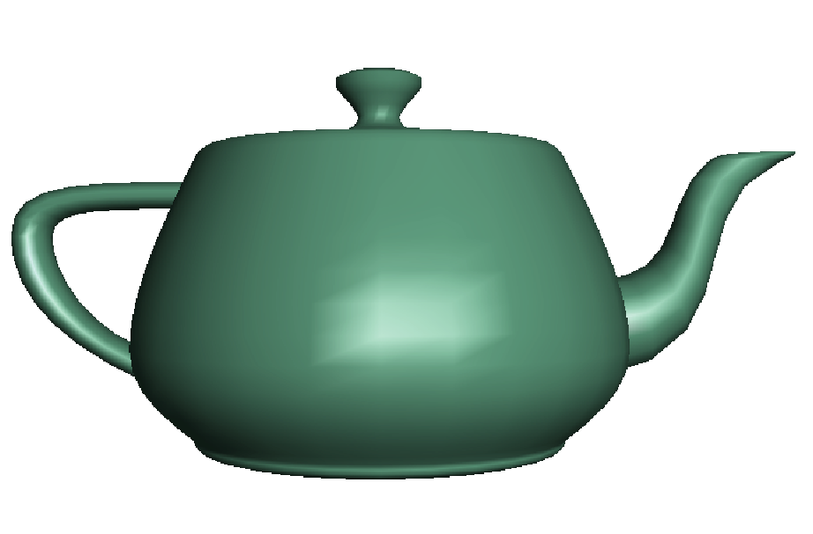
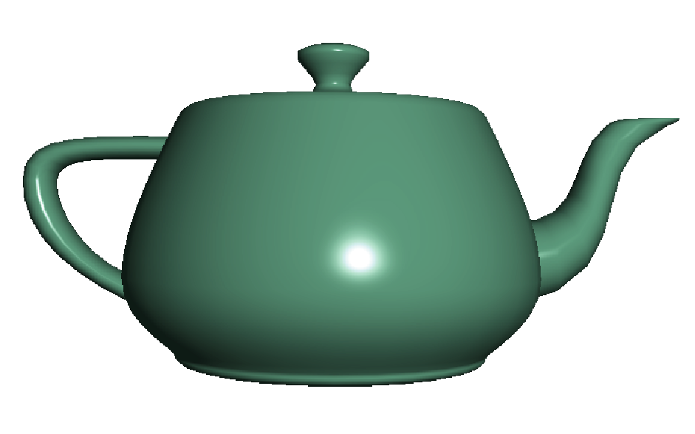
Fragment Shader Applications
Per fragment lighting calculations
per vertex lighting
per fragment lighting

Slide 43
Vertex Shader for per Fragment Lighting
varying vec3 N, L, E, H;
void main() {
gl_Position = gl_ModelViewProjectionMatrix * gl_Vertex;
vec4 eyePosition = gl_ModelViewMatrix * gl_Vertex;
vec4 eyeLightPos = gl_LightSource[0].position;
N = normalize(gl_NormalMatrix * gl_Normal);
L = normalize(eyeLightPos.xyz - eyePosition.xyz);
E = -normalize(eyePosition.xyz);
H = normalize(L + E);
}

Slide 44
Fragment Shader for Modified Phong Lighting I
varying vec3 N;
varying vec3 L;
varying vec3 E;
varying vec3 H;
void main()
{
vec3 Normal = normalize(N);
vec3 Light = normalize(L);
vec3 Eye = normalize(E);
vec3 Half = normalize(H);

Slide 45
Fragment Shader for Modified Phong Lighting II
float Kd = max(dot(Normal, Light), 0.0);
float Ks = pow(max(dot(Half, Normal), 0.0),
gl_FrontMaterial.shininess);
float Ka = 0.0;
vec4 diffuse = Kd * gl_FrontLightProduct[0].diffuse;
vec4 specular = Ks * gl_FrontLightProduct[0].specular;
vec4 ambient = Ka * gl_FrontLightProduct[0].ambient;
gl_FragColor = ambient + diffuse + specular;
}

Slide 46
Modeling with Curves
interpolating data point
data points
approximating curve

Slide 47
Parametric Surfaces
Surfaces require 2 parameters
x=x(u,v)
y=y(u,v)
z=z(u,v)
p(u,v) = [x(u,v), y(u,v), z(u,v)]^{T}
Want same properties as curves:
Smoothness
Differentiability
Ease of evaluation
y
p(u,1)
p(0,v)
p(1,v)
x
z
p(u,0)

Slide 48
Cubic Parametric Polynomials
N=M=L=3, gives balance between ease of evaluation and flexibility in design
Four coefficients to determine for each of x, y and z
Seek four independent conditions for various values of u resulting in 4 equations in 4 unknowns for each of x, y and z
Conditions are a mixture of continuity requirements at the join points and conditions for fitting the data

Slide 49
Hermite Form
p’(0)
p’(1)
p(0)
p(1)
Use two interpolating conditions and
two derivative conditions per segment
Ensures continuity and first derivative
continuity between segments

Slide 50
Equations
Interpolating conditions are the same at ends
p(0) = p₀ = c₀
p(1) = p₃ = c₀+c₁+c₂+c₃
Differentiating we find p’(u) = c₁+2uc₂+3u²c₃
Evaluating at end points
p’(0) = p’₀ = c₁
p’(1) = p’₃ = c₁+2c₂+3c₃

Slide 51
Matrix Form
Solving, we find c=M_{H}q where M_{H} is the Hermite matrix

Slide 52
Bezier: Approximating Derivatives
p₁
p₂
p₁ located at u=1/3
p₂ located at u=2/3
slope p’(0)
slope p’(1)
p₀
p₃
u

Slide 53
Equations
Interpolating conditions are the same
p(0) = p₀ = c₀
p(1) = p₃ = c₀+c₁+c₂+c₃
Approximating derivative conditions
p’(0) = 3(p₁- p₀) = c₀
p’(1) = 3(p₃- p₂) = c₁+2c₂+3c₃
Solve four linear equations for c=M_{B}p

Slide 54
Bezier Matrix
p(u) = u^{T}M_{B}p = b(u)^{T}p
blending functions

